Slide 1
AIPI 540 – Team #2 Presentation: Computer Vision Identifying Disasters from Different Perspectives Amani Johnson-Singh-Barnett Stephanie Horng Colin Bryan
Notes:
For our project, we explored the feasibility of personalized prediction tool for patient with AD and memory impairment.

Slide 2
Table of Contents
Introduction
Define the Problem
Purpose & Objective
Gather, Validate, & Explore Data
Data Pipeline & Modeling
Evaluation of Results
Conclusion
Citations
Notes:
The organization of this presentation follows the CRISP-DM steps outlined here – that we’re all familiar with.

Slide 3
Introduction
Background & Situation
With the increasing adoption of social media and aerial drones across the globe, there is an opportunity for artificial intelligence to analyze images in disaster-prone areas and identify disaster events in real-time.
Recent research in disaster informatics demonstrates a practical and important use case of artificial intelligence to identify disasters in real-time to aid emergency personnel in coordinating first response.

Slide 4
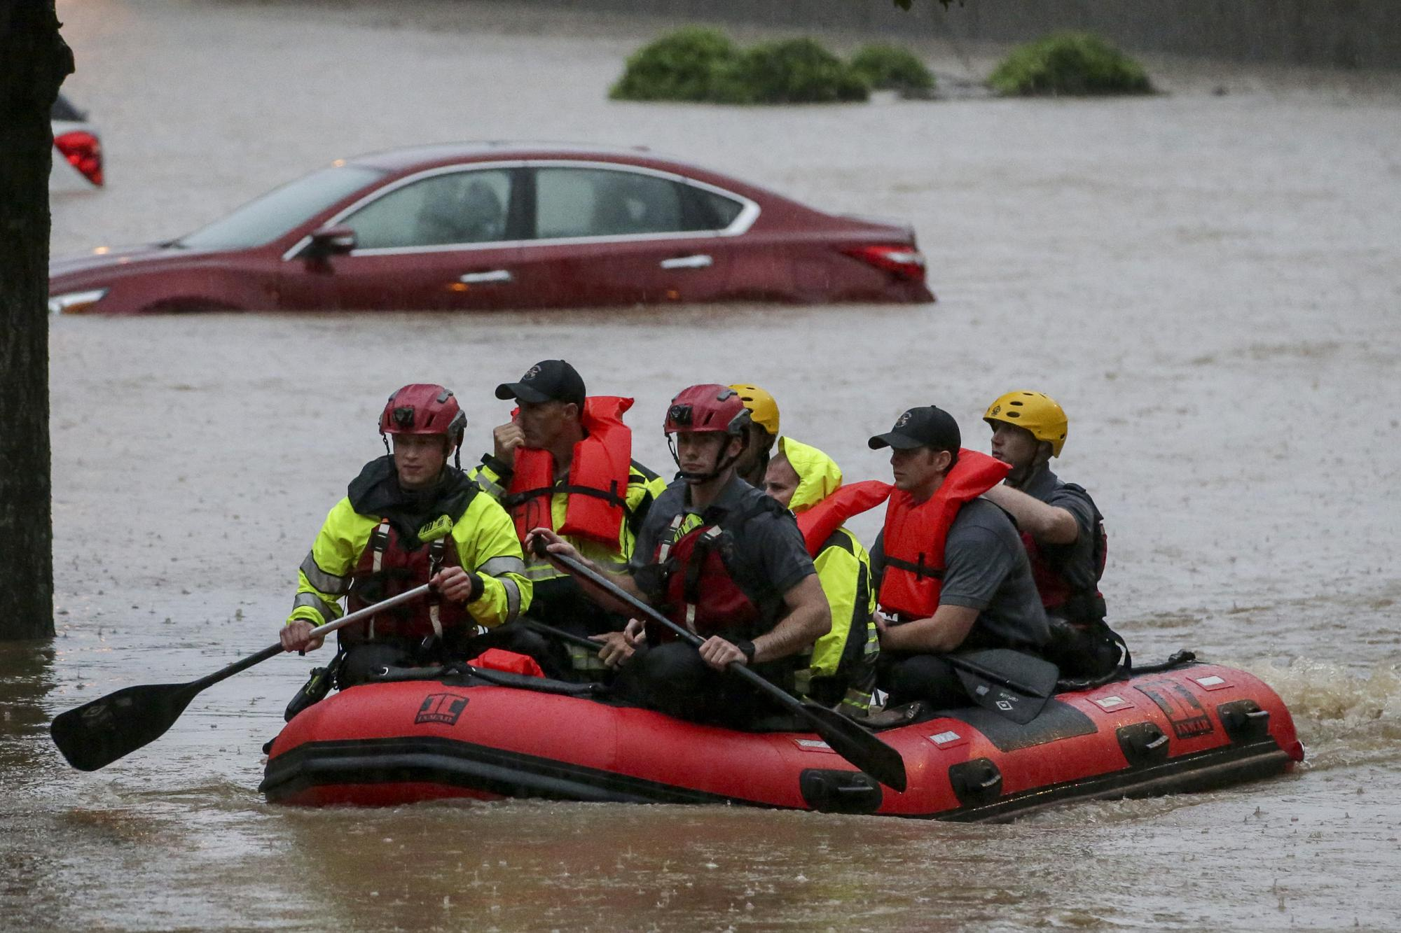
Define the Problem
Natural disasters are increasingly common today compared to history* and are putting a strain on the resources of emergency first responder organizations.
According to OCHA (the United Nations Office for the Coordination of Human Affairs), the first 72 hours of disaster response are critical.**
Emergency organizations need technological advantages to handle the increasing volume of natural disasters and reduce humanitarian impact.
* Source: Link
** Source: Link

Slide 5
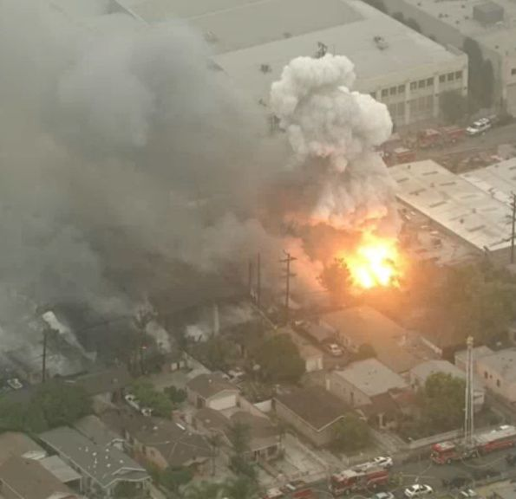
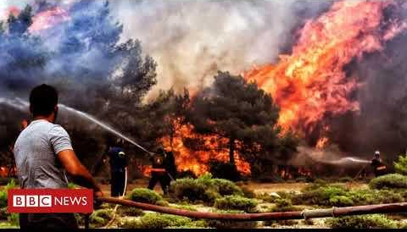
Purpose & Objective
Aerial Example
Purpose: Classify images by disaster type to “proof-of-concept” how neural network applications can lead to valuable tools for emergency response and disaster management applications. To limit the scope of our model, we focused on classifying images as a fire, flood, or non-disaster.
Objective: Deploy a neural network model as a proof-of-concept to identify a subset of natural disasters regardless of image vantage point.
Ground-Level Example

Slide 6
Gather Data: Aerial Dataset
Dataset One: “AIDER”
Source: Deep-Learning-Based Aerial Image Classification For Emergency Response Applications Using Unmanned Aerial Vehicles(3.1 dataset collection)
Dataset was compiled through manual collection of images of disaster events*:
521 images of fire/smoke**
526 images of flood**
320 images of collapsed buildings/rubble
335 images of traffic accidents
4390 images normal case**
* Image sources: world-wide-web, google images, Bing images, YouTube, news agencies web sites, other databases of general aerial images, images collected using the author’s own unmanned aerial platform
** Highlights indicate use in Team 2’s computer vision project

Slide 7
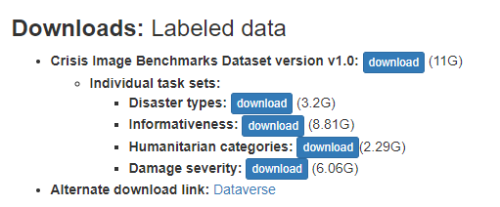
Gather Data: Ground-Level Dataset**
Dataset Two: “MEDIC”
Source: MEDIC: A Multi-Task Learning Dataset for Disaster Image Classification(Table 4)
*Image sources: Crisis Benchmark: images from Twitter, Google, Bing, Flickr and Instagram
**In manual exploration of dataset, over 95% of images were noted to be from ground-level
*

Slide 8
Validate & Explore Data
MEDIC and AIDER Analysis:
Evaluated datasets for similarities and differences in preparation for combining into one training set
Considerations: To limit the scope of our model for this proof-of-concept, we focused on classifying images as a fire, flood, or non-disaster. Although this “non-disaster” label may be misleading for images of other disaster types, the aerial image dataset and ground-level image dataset we used for this project only overlapped on fires and floods. Thus, those were the labels we used for our training data.
Summary:
Maintained class imbalance between aerial and ground images for realistic application (i.e., more images will be submitted from ground-level than aerial vantage point)
Analyzed differences in labels between datasets to inform data preparation. MEDIC’s labeling was more built-out than AIDER’s labeling
Missing images in MEDIC dataset were filtered out in data preparation phase

Slide 9
Unique Approach: Combining Datasets
AIDER
Filtering
Dataset Used
for Model Training
Filtering
MEDIC

Slide 10
Pipeline & Modeling Approach
Load Datasets
ResNet50 Architecture w/ Transfer Learning
Train Models on all 3 datasets
Filtering & Preparation
Split into Training & Validation
Validation
Image Augmentation for Training
Combine Datasets
Evaluate Results & Conclusions

Slide 11
Data Preparation
Summary:
Across AIDER and MEDIC datasets, filter into 3 Classes: Flood, Fire, and “Not Disaster”
Removed missing images from datasets
Set up a class to add labels, manipulate images to size correctly, and augment data for training purposes
Combined into custom dataset
Split all 3 datasets (AIDER, MEDIC, and combined) into training and validation sets

Slide 12
Data Preparation: AIDER
Original file structure:
Folders labelled “fire”, “flood”, “normal”
Manually reorganized file structure in order to use ImageFolder to create datasets:
“train” and “val” folders, each with “fire”, “flood”, “normal” folders
Split about 80/20 for train/val:
Train: 421 fire (#101-521), 426 flood (#101-426), 3390 normal (#1001-4390)
Val: 100 fire (#1-100), 100 flood (#1-100), 1000 normal (#1-1000)

Slide 13
Data Preparation: MEDIC
Read in tsv files as dataframe:
consolidated_disaster_types_train_final.tsv
consolidated_disaster_types_test_final.tsv
Filtered for rows
values “flood”, “fire”, “not_disaster” for “class_label” column
Filtered for columns
“image_path” and “class_label”
Filtered for rows
checked that images existed for all paths and removed missing images
Generate datasets using custom dataset class

Slide 14
Data Preparation: Combined
Create train and val dataframes with AIDER image paths and class labels and concatenate it with the corresponding filtered MEDIC train and val dataframes
Ex. AIDER flood val folder has the first 100 images labelled “flood_image_0001.jpg” ,…, “flood_image_0100.jpg”
All AIDER folders have similar filename structures
Generate image paths using the given range/bounds with string formatting;
To standardize labels, images with the “normal” class will have the label “not_disaster”
Use same custom dataset class MEDIC uses

Slide 15
Model Selection & Metric Analysis
Model Selection: ResNet50 and transfer learning
From class learnings and research, we decided on using a pre-trained ResNet50 model with transfer learning for our proof-of-concept project.
ResNet50 is noted for excellent generalization performance with fewer error rates on recognition tasks.
Metric Analysis:
Accuracy, Precision, Recall, and f1-score for:
MEDIC
AIDER
Custom combined dataset

Slide 16
Observations
Training Statistics
Combined time was 1 hour 38 minutes and 23 seconds for all 3 datasets
Used Batch size of 36 images and 25 epochs for each dataset
Summary of Observations
Validation accuracy metrics were higher than training accuracy for each epoch across AIDER, MEDIC, and Combined datasets
Possible Explanation: Class imbalance results in too many images belonging to the majority class (not disaster) and our model does a better job predicting these
The “Flood” class had lower precision, recall, and f1-score in the Combined dataset relative to the AIDER-only and MEDIC-only datasets
Possible Explanation: Not enough training data for flood class or floods are difficult for our model to classify from multiple vantage points

Slide 17
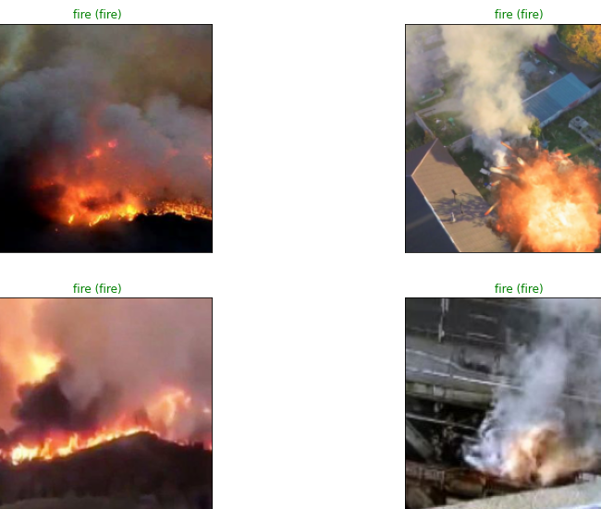
Example of Results

Slide 18
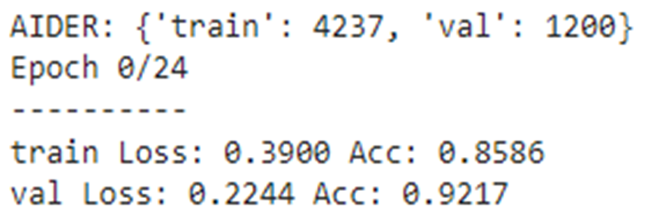
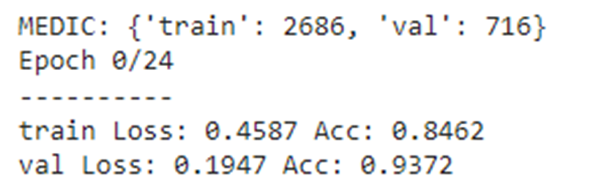
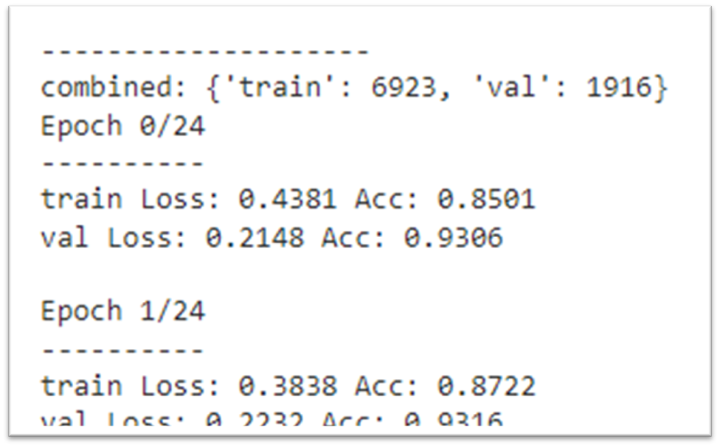
Evaluation– Accuracy (first epoch)
AIDER
MEDIC
Combined

Slide 19
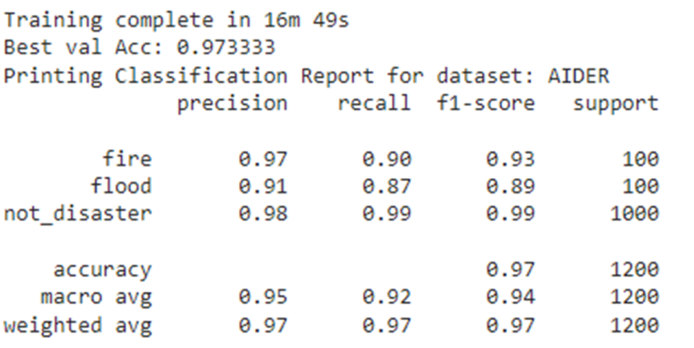
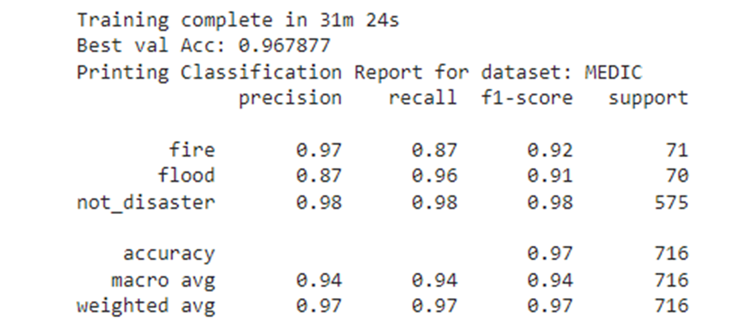
Evaluation – Precision, Recall, & f1
AIDER
MEDIC
AIDER-only and MEDIC-only metrics were relatively good, but….

Slide 20
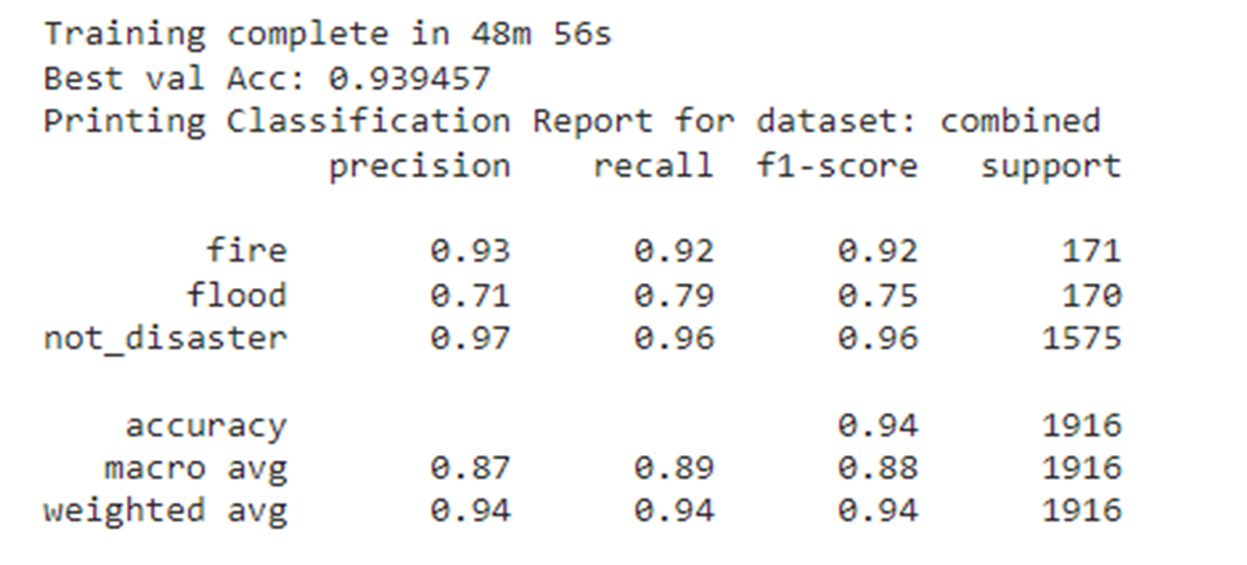

Evaluation – Precision, Recall, & f1
Combined
Flood performance was noticeably worse in the combined dataset

Slide 21
Conclusion
Summary:
A neural network model to assist in disaster detection from multiple vantage points is a project worth pursuing. In the future, performance/computational resource tradeoffs of the model should be optimized
The proof-of-concept model can be improved upon to predict other classes of disaster types, understand severity, and suggest emergency personnel response needs
More training data, parameter changes, or a different model architecture can be explored to improve on results in a combined aerial and ground-level vantage point dataset
Ideal Outcomes:
One model for real-time disaster detection and emergency personnel alerts (potentially on mounted or UAV hardware)
Resource and time savings for emergency responders
More lives are saved as disaster frequency increases

Slide 22
MEDIC Citations
Firoj Alam, Ferda Ofli, Muhammad Imran, Tanvirul Alam, Umair Qazi, Deep Learning Benchmarks and Datasets for Social Media Image Classification for Disaster Response, In 2020 IEEE/ACM International Conference on Advances in Social Networks Analysis and Mining (ASONAM), 2020. [Bibtex] [Arxiv]
Firoj Alam, Ferda Ofli, and Muhammad Imran, CrisisMMD: Multimodal Twitter Datasets from Natural Disasters. In Proceedings of the 12th International AAAI Conference on Web and Social Media (ICWSM), 2018, Stanford, California, USA. [Bibtex]
Hussein Mozannar, Yara Rizk, and Mariette Awad, Damage Identification in Social Media Posts using Multimodal Deep Learning, In Proc. of ISCRAM, May 2018, pp. 529–543.

Slide 23
AIDER Citations
C. Kyrkou and T. Theocharides, "Deep-Learning-Based Aerial Image Classification for Emergency Response Applications Using Unmanned Aerial Vehicles," 2019 IEEE/CVF Conference on Computer Vision and Pattern Recognition Workshops (CVPRW), 2019, pp. 517-525, doi: 10.1109/CVPRW.2019.00077.

Slide 24
Citations
Mateusz Buda, Atsuto Maki, and Maciej A Mazurowski. A systematic study of the class imbalance problem in convolutional neural networks. Neural Networks, 106:249–259, 2018.

